Slide 1
2019 Legislative Session Update
Power Accountants Association
Annual Meeting
May 17, 2019
Jeremy Elrod
Director of Government Relations

Slide 2
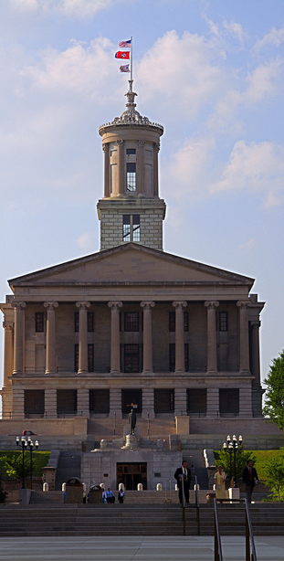
Who is TMEPA?
Formed in 1966
Tennessee’s 60 municipal electric utilities
Lobby primarily in Nashville
Also in Washington, D.C.
Multi-service utilities
29 offer water/wastewater service
13 offer broadband
11 offer natural gas

Slide 3
TMEPA Members
Serve 2.4 million homes and businesses
67% of state’s electric customers
75% of the state’s electricity
Collectively hold $9.1 billion in assets
Pay $200 million in PILOT to local governments
Employ over 7,000 people

Slide 4
Issues We Lobby On
Pole attachments
Small cell antennas
“Smart” meters
Rates, fees, billing
Sales tax
Utility board membership and policies
Utility manager contract
Municipal broadband expansion
Connections, cut-offs and collections
Round-up programs
Renewable power generation
Cities selling utilities
Bidding policies
Open records/meetings
Cell phone use
Criminal offenses
Employment and workers compensation
Eminent domain
Economic development

Slide 5
Who We Work With
TN-FOC – Tennessee Fiber Optic Communities
Broadband divisions of seven municipal electric utilities that provide fiber to the home
TECA – Tennessee Electric Cooperative Association
Tennessee’s 23 electric cooperatives
TML – Tennessee Municipal League
Tennessee’s municipalities
TAUD - Tennessee Association of Utility Districts
Water utility districts
Municipal water utilities
TGA – Tennessee Gas Association
Gas utility districts, municipal gas utilities and for-profit gas utilities
TVPPA – Tennessee Valley Public Power Association
All local power companies (LPCs) TVA sells electricity to
Both municipals and cooperatives
Parts of seven states - Tennessee, Kentucky, Georgia, North Carolina, Alabama, Mississippi
American Public Power Association
National trade organization for municipal and publicly owned electric utilities
Lobbies federal government
Files federal lawsuits and comments

Slide 6
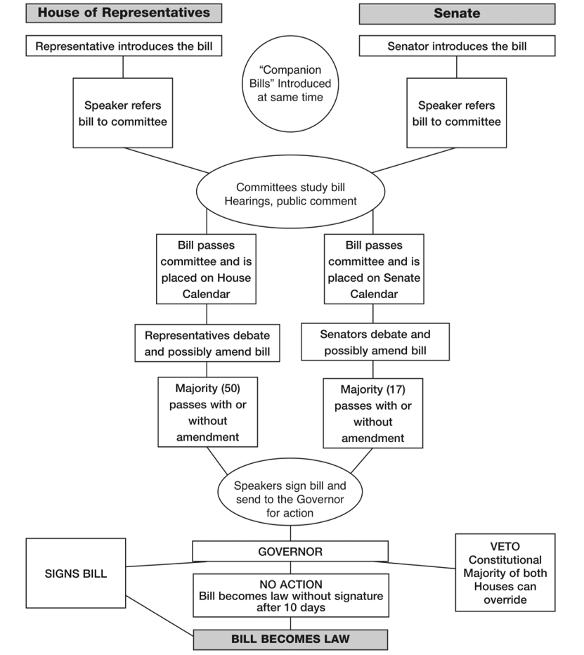
First Session of 111th Tennessee General Assembly
General Assembly term lasts two years
Roughly 1550 bills filed in 2019
TMEPA followed 464 bills
Bills that don’t pass this year carry over to next year
House
73 Republicans and 26 Democrats
26 new state representatives this year (1/4 of the House)
Senate
28 Republicans and 5 Democrats
6 new state senators (1/5 of the Senate)

Slide 7
Utility Legislation Passed This Year

Slide 8
Allowing Optional Charges and Payments on Utility Bills
2018 MTAS opinion said utilities can’t include payments for water/sewer leak protection or insurance from third parties on utility bills
Argued third party using utility billing system for free
Legislation clarifies state law to clearly say municipal utilities and utility districts can include on customer’s utility bill:
Water, wastewater and gas line insurance
Water , wastewater and gas leak protection coverage
Electric equipment payments
Can terminate electric service for non-payment
Public Chapter 228

Slide 9
Changes to Utility Round-up Programs
Requires round-up programs started after January 2021 to be opt-in programs
Utilities have until January 2021 to start an opt-out program
Current opt-out programs can keep operating as opt-out
Utilities with any type of round-up program must put information about it on their website
Opt-out programs must notify customers in writing
HB377/SB308

Slide 10
Round-up Information on Utility’s Website for Every Program
Applies to both opt-in and opt-out programs
Information required to be put on a utility’s website by November 1, 2020:
Statement that utility has a round-up program and a program description
Notification that a customer whose bill is currently rounded up has the right to opt out of participation in the program
Contact information for the utility and instructions on how the customer may contact the utility to opt into or out of the program

Slide 11
Notification to Customers in Opt-out Round-up Programs
Written notice to each customer by November 1, 2020
Notice must include:
Statement that utility has an opt-out round-up program with a program description
Notification that a customer whose bill is currently rounded up has the right to opt out of participation
Contact information for utility and instructions on how customer may contact the utility to opt out
Notification “may be provided to the customer by electronic means and may accompany a regular billing statement, at the discretion of the municipality”

Slide 12
Utility Related Criminal Offenses
Critical utility infrastructure vandalism – Public Chapter 370
Statute already included electric, telephone, communication, gas, railroad
Modernized statute and adds water, wastewater and oil pipeline
Assault of utility employee – Public Chapter 149
Increases maximum fine to $15,000 for aggravated assault of “identifiable employee or contractor of a utility”
Drones prohibited over critical infrastructure – Public Chapter 60
State law already prohibits drone use over (among other things):
Electrical generation system, transmission system, or distribution substation
Water or wastewater treatment facility
Facility, equipment, or pipeline infrastructure for storage, transmission, or distribution of natural gas or propane
Bill adds communication service facilities
Class E felony

Slide 13
Exemptions for Utilities
Requiring hands-free cell phone use while driving
Exempts “employees or contractors of utility services providers acting within the scope of their employment”
SB173-HB164
Prohibiting loitering or commercial activity in or around median of state highway – Public Chapter 184
Exempts “[e]mployees of, or agents, contractors, or other persons who are under contract with, or acting on behalf of, a county, municipality,…or a utility, and who are permitted by the department of transportation to stand or conduct any activity in, or in proximity to, the median of a state highway”

Slide 14
Linemen Specialty License Plate
“Linemen Power Tennessee” Specialty License Plate
Proceeds from sales of plate to go to Tennessee Lineworker Lifeline Fund
Available for purchase in about six months
Public Chapter 253
Pre-production mock-up of what plate could look like

Slide 15
More Utility Bills
Nashville Electric Service – Public Chapter 237
Removes state statute that singled out NES’s requirements for cut-off procedures
Facilitating Business Rapid Response to State Declared Disaster Act – Public Chapter 378
Establishes taxes and fees to be paid by responding out-of-state businesses and protections for out-of-state businesses and their employees that come to Tennessee to help with disaster response
Passed in 20+ other states

Slide 16
Water and Wastewater Bills
Sales tax exemption for water used for agricultural purposes – SB1460/HB634
Must show Tennessee agriculture exemption certificate/card or a streamlined exemption certificate to utilize the exemption
Online water utility board training – Public Chapter 41
Currently have to send affidavit to comptroller’s office, which this bill removes
Changes so board members gets a certificate after training, utility holds on to it for six years

Slide 17
Water and Wastewater Bills
Septic tanks during sewer moratorium – Public Chapter 116
TDEC can’t deny a permit for septic tank solely because there is a moratorium on new connections
Seller must disclose potential future fees/costs to connect
Local governments and utilities still can require developers and contractors to build out and have other requirements

Slide 18
Broadband
$20 million in state budget for Tennessee Broadband Accessibility Grants
Public Chapter SB1458/HB605
Exempts from sales tax fiber-optic cable after it has become attached to a utility pole, building, or other structure or installed underground

Slide 19
Local Government Bills Passed This Year

Slide 20
Contracting for Banking Services
Cities must contract with a bank for deposit of municipal funds
Does not apply to municipal utilities unless the city manages utility funds and bank accounts
At least once every four years and at least once during a mayor's term, city council must evaluate whether the contract should be rebid
Get bids from at least two banks
Must “consider the bank or banks proposing the highest interest rate, potential service charges or other fees, factors affecting safety and liquidity of municipal funds, and any other relevant factors”
Must secure municipal funds with same requirements as state deposits (title 9, chapter 4, parts 1 and 4) or as a collateral pool (title 9, chapter 4, part 5)
Public Chapter 277

Slide 21
TCRS Bills
Public Chapter 382
Deletes provision that establishes that employer contributions must be credited to the Optional Retirement Fund and are not refundable for any reason, except death
Prohibits employers participating in TCRS from requiring an employee who has completed a temporary period of employment before becoming eligible for TCRS to complete an additional temporary employment period if such employee has been terminated and subsequently rehired by the employer
Establishes that a current early service retiree shall not change to disability retirement and vice versa
Other various small changes in TCRS statute
Public Chapter 399
Grants a retirement allowance to surviving spouse who is a designated beneficiary if the deceased TCRS member is vested instead of requiring that the member have 10 years of creditable service

Slide 22
Local Government Bills
Public Chapter 337
Requires consideration of 20-factor test in IRS Revenue Ruling 87-41 to determine whether worker is independent contractor and whether employer-employee relationship exists in certain employment arrangements
Public Chapter 338
Authorizes cities and counties to enter into contracts for surveying services through a procurement process similar to the current one for engineering and architectural services
Public Chapter 325
Establishes right of subrogation under local government entity's group life, hospitalization, disability, or medical insurance plan

Slide 23
Local Government Bills
SB557/HB1089
Property owner can vote in annexation referendums up to two owners per property
Public Chapter 331
Authorizes an attorney for a local government to seek an injunction against a person who harasses an employee
SB1262/HB594
Settlement agreement provisions that have purpose or effect of concealing identities of persons relating to a claim are void and unenforceable if settlement agreement is entered into by governmental entity
Maintains confidentiality of victim's identity if the claim involves sexual harassment or sexual assault.

Slide 24
$400 Professional Privilege Tax Removed for Many Professions
Accountants
Architects
Athlete Agents
Audiologists
Chiropractors
Dentists
Engineers
Landscape Architects
Optometrists
Pharmacists
Podiatrists
Psychologists
Real Estate Brokers
Speech Pathologist
Veterinarians
Remained for:
Lobbyists
Broker-dealers
Investment Advisers
Physicians
Attorneys

Slide 25
Bills That Didn’t Pass This Year

Slide 26
This Year’s Smart Meter Bill
SB526/HB1149
Would have prohibited utilities from selling, sharing, or disclosing information collected from metering system to a third party unless the information is aggregated to make customers anonymous
How do you bill a customer if can’t report to the billing company how much power it used?
Bill drafting matters – only applied to utility districts, electric cooperatives, and IOUs

Slide 27
Local Government Bills
SB600/HB635
Required local governments to accept bids through an online interactive bidding website
SB480/HB617 and SB484/HB530
Required local governments utilize public bidding when purchasing insurance
SB1165/HB1239
Prohibited governmental entities from contracting with people who will not provide proof of work authorization status

Slide 28
Open Records
SB590/HB626
Local government could stop filling public records requests from someone if requests constitute harassment
Require every state and local government council, commission, board and committee to put on website “basic government information” before meetings
Agendas, board packets, contact information, etc.
SB434/HB223
Currently, charge for copies of records but free to inspect records
Bill would have required local governments to allow requestors to take photos of records

Slide 29
Selling Utilities
SB532/HB604
Requires Tennessee Public Service Commission to accept when water IOU purchases municipal water/wastewater utility for fair market value
Essentially allows IOU to set rates however they want for customers of the utility being bought
Municipal water/wastewater utilities with less than 10,000 customers
SB1414/HB1281
Establishes voluntary process for utility district to be sold to an IOU

Slide 30
Issues and Trends to Watch For

Slide 31
Coming Next Year? Or the Next?
Putting meeting agendas and documents on local government website
Process for IOUs to purchase municipal water/wastewater utilities and utility districts
Broadband
Net metering
Green Tea Party
Third party solar
Smart meter
FCC Small Cell Order***

Slide 32
For a copy of this presentation or more information on anything presented
jelrod@tmepa.org

